Slide 1

WNR Final Presentation
5/2/2016
Notes:
TK

Slide 2

Video URL: https://youtu.be/p68fC0B_VRU

Slide 3

Motivation
Notes:
TK

Slide 4
Customer Needs
Safety & Regulations
FDA Medical Device & HIPPA Data Privacy Requirements
Do not heat up the surrounding skin by a change of more than 2℃/3.6℉
No leakage current from device into brain
Real-time, accurate, and comprehensive data collection
Wireless Data link with adequate bandwidth and throughput sending to an external device
Sample and send data from all 16 electrodes on 16 probes with sufficient bit resolution
Encrypt and decrypt data with no loss in resolution
Convenience, portability, and long-lasting
Independent usability of each probe without the need to physically network probes in a grid
Compact and lightweight form factor that does not interfere with other probes
Battery should last at least a working day and be easily user-replaceable
Notes:
TK

Slide 5
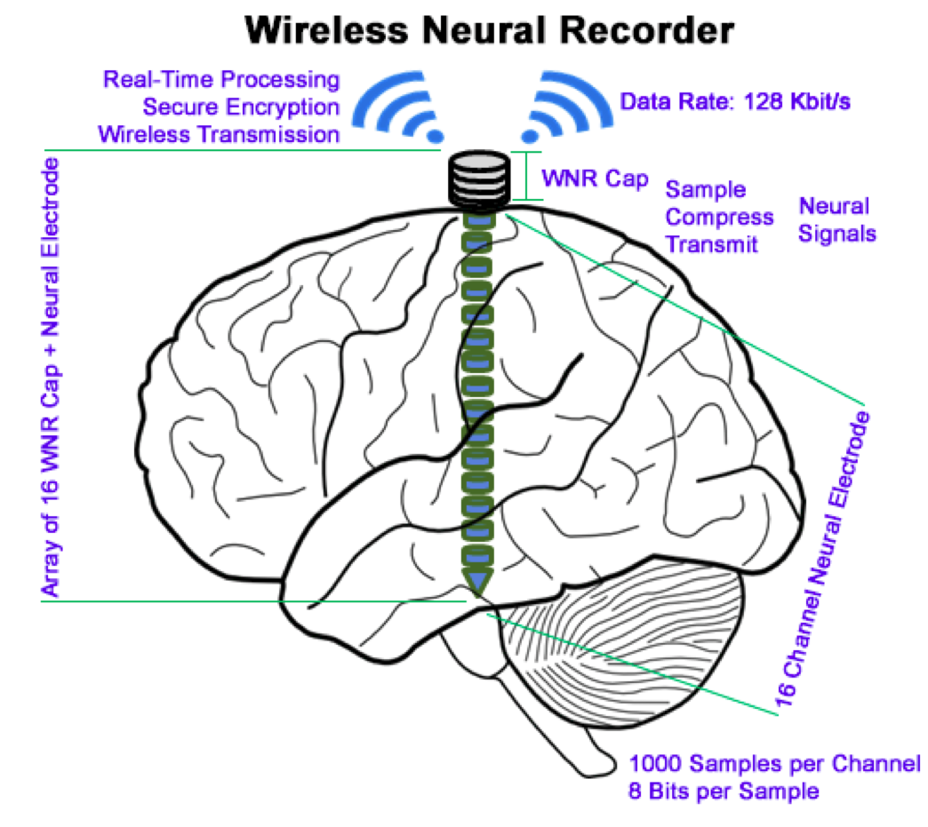
Task
To develop an array of small, secure, high-throughput, low-power Wireless Neural Recorder(WNR) caps that can be screwed independently onto ECoG electrode for wireless transmission of neural data.
Notes:
TK

Slide 6
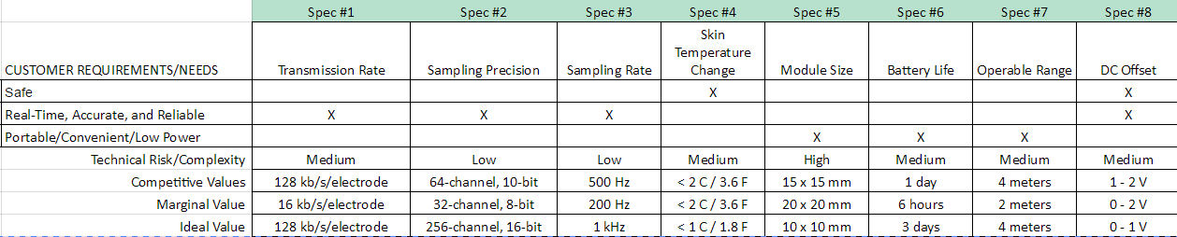
Design Goals
Notes:
TK

Slide 7
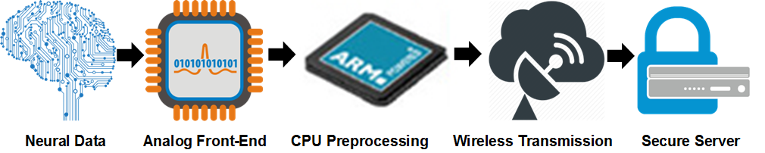
System Breakup
Notes:
TK

Slide 8
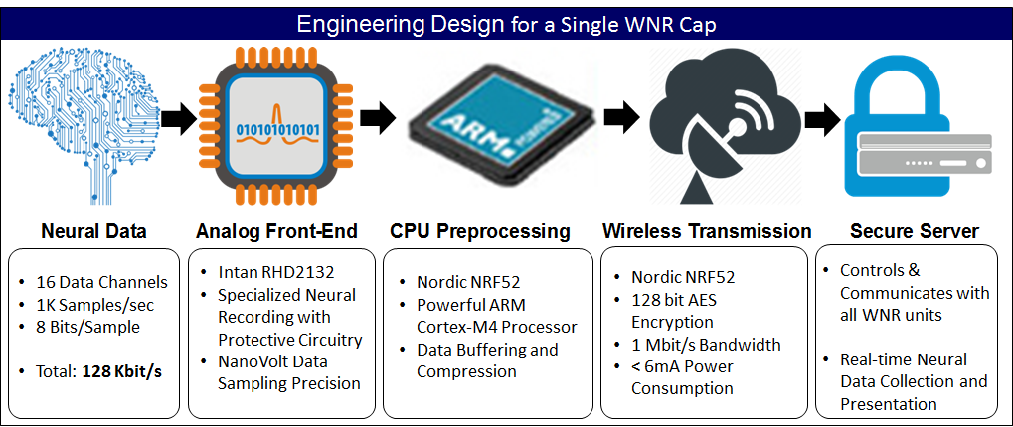
Design Choices
Notes:
TK

Slide 9
Design Goals
Notes:
TK

Slide 10
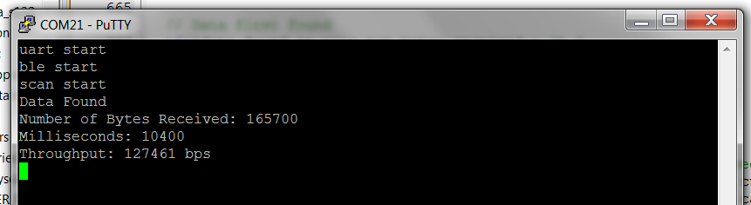
Results - Transmission Rate
Aggregate Transmission Rate = 128 kbps
= 16 kbps/electrode * 8 electrodes

Slide 11
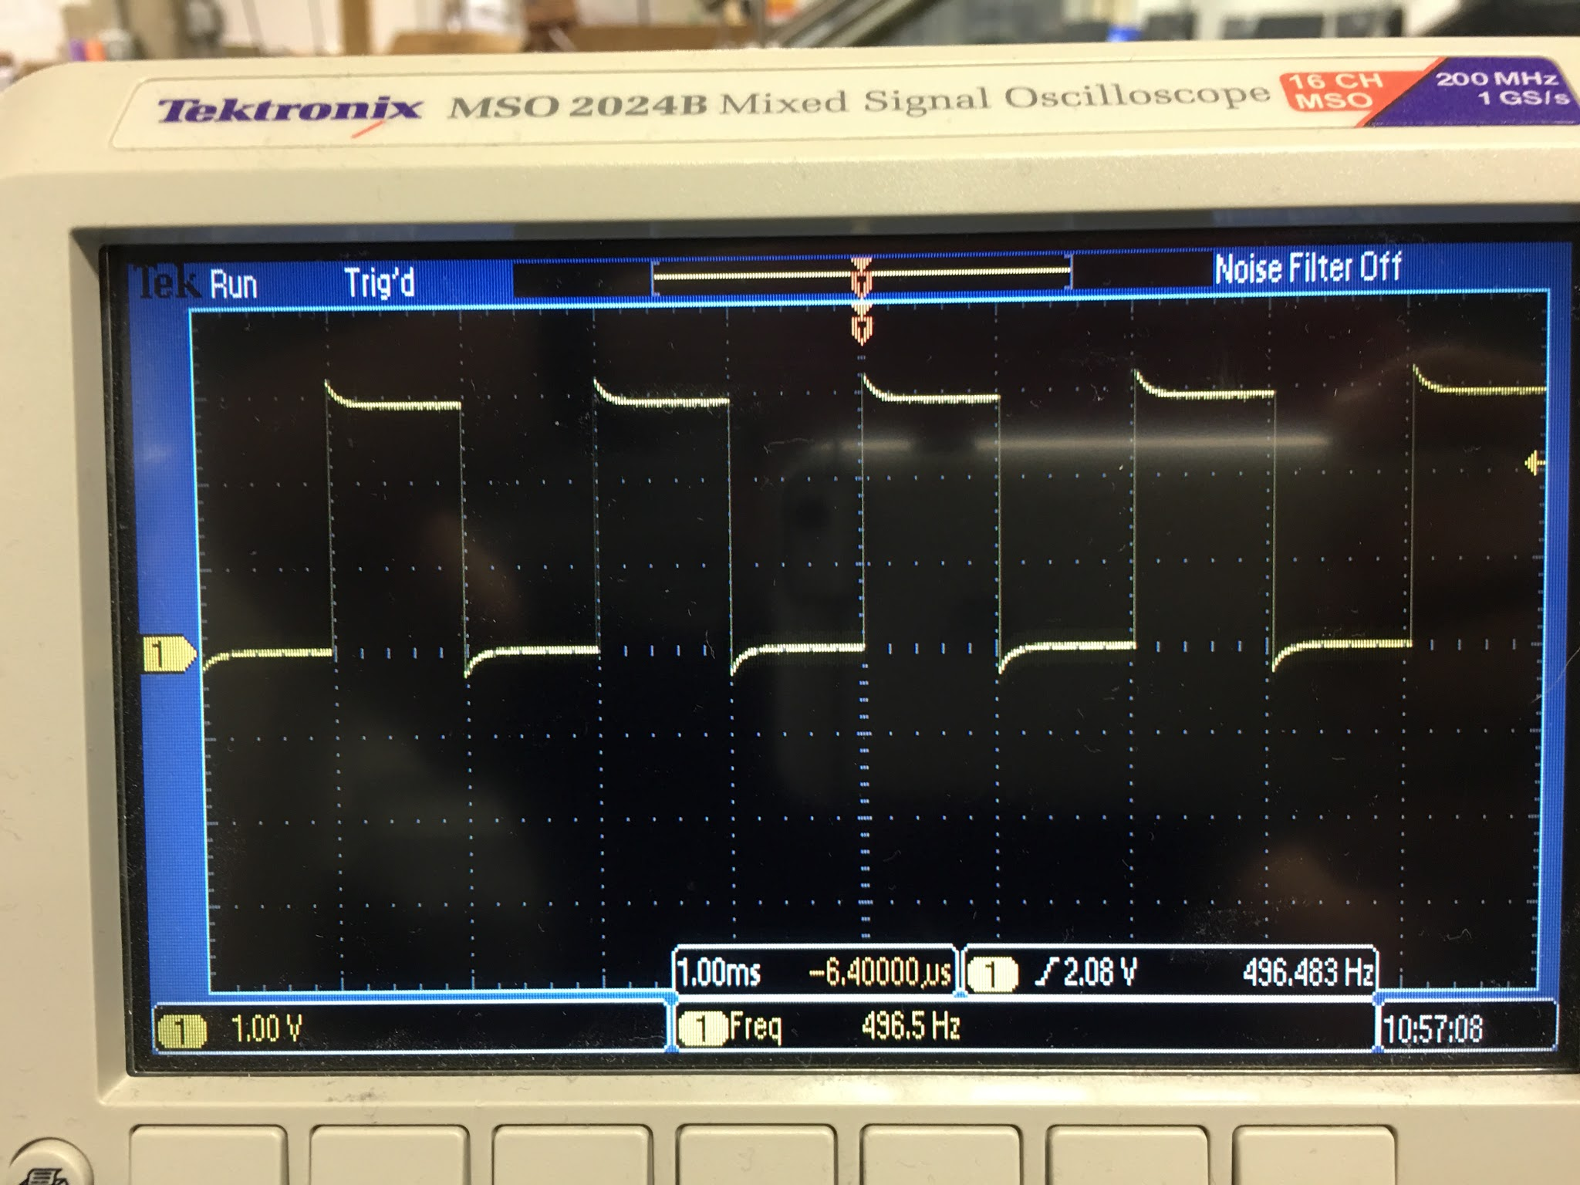
Results - Sampling Rate
“The rate and timing of SPI commands sent to the chip determines the sampling rate”
Intan RHD2000 Datasheet P.35
Sampling Frequency = 496.5*2
= 993Hz

Slide 12

Results - Skin Temperature Change
Cannot be measured because the prototype is missing, but:
Power Consumption ~ 19 mA
Skin Temperature Change should be < 1 ºC

Slide 13
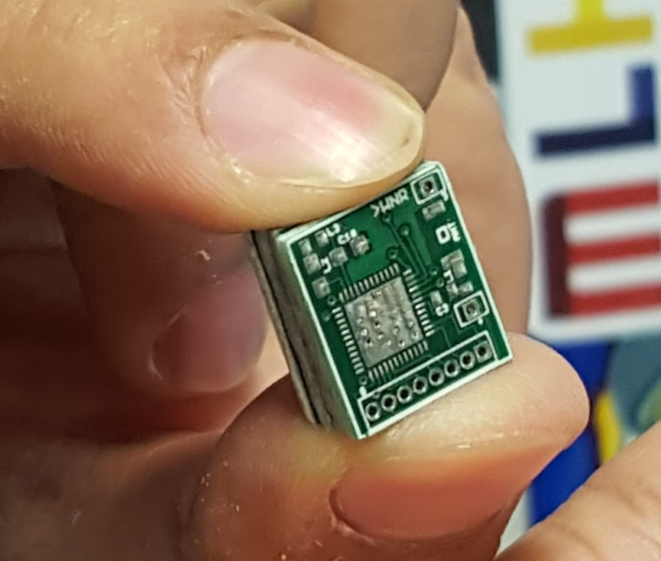
Results - Module Size
12mm x 14mm

Slide 14
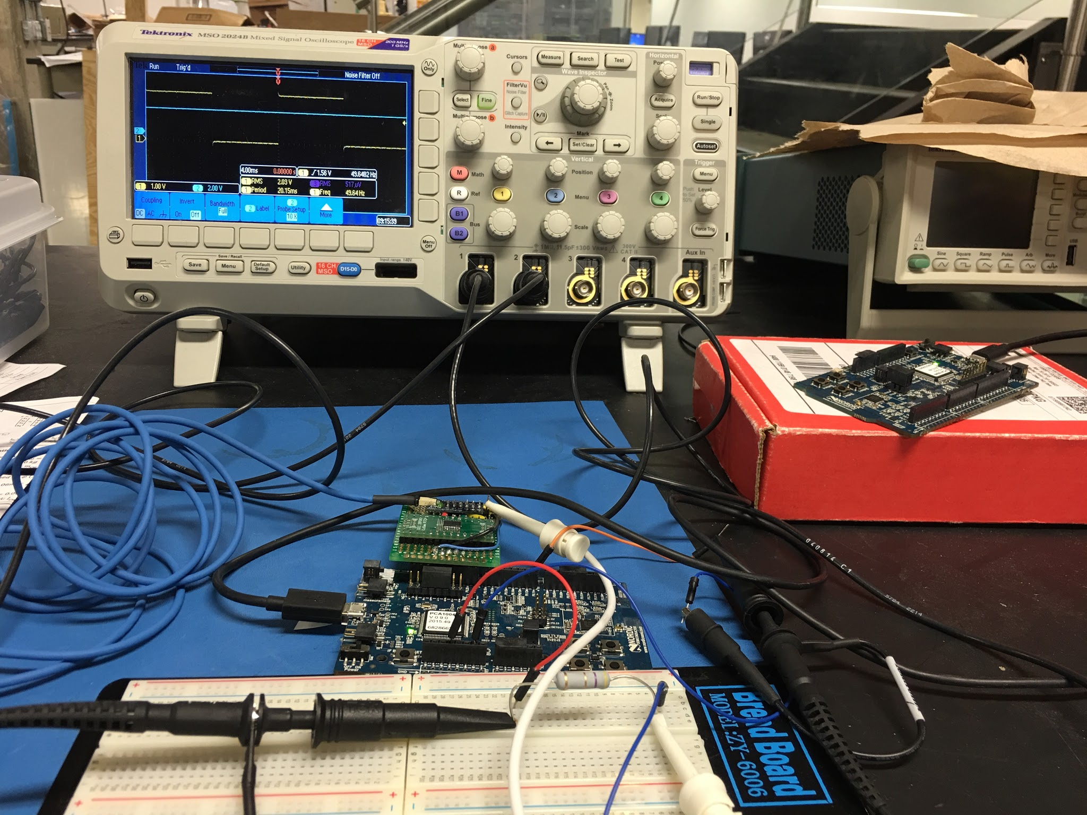
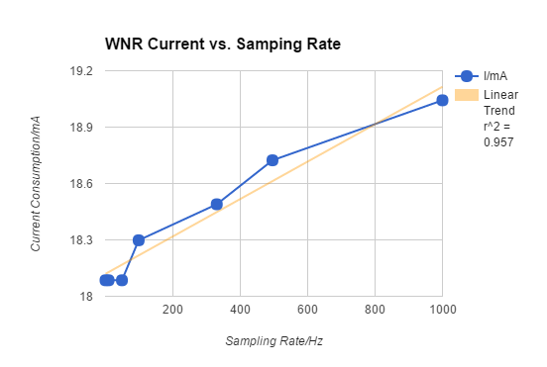
Results - Battery Life
I = 0.9961E-3 * f + 18.119
18.12 + 1 mA/kHz

Slide 15
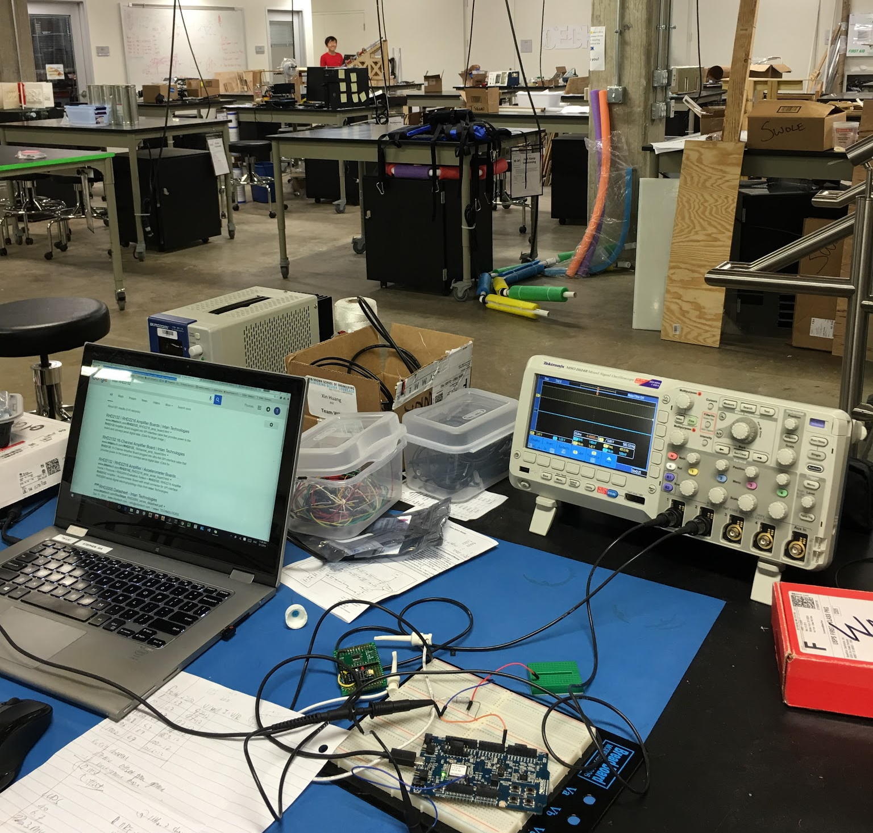
Results - Operable Range
15m

Slide 16
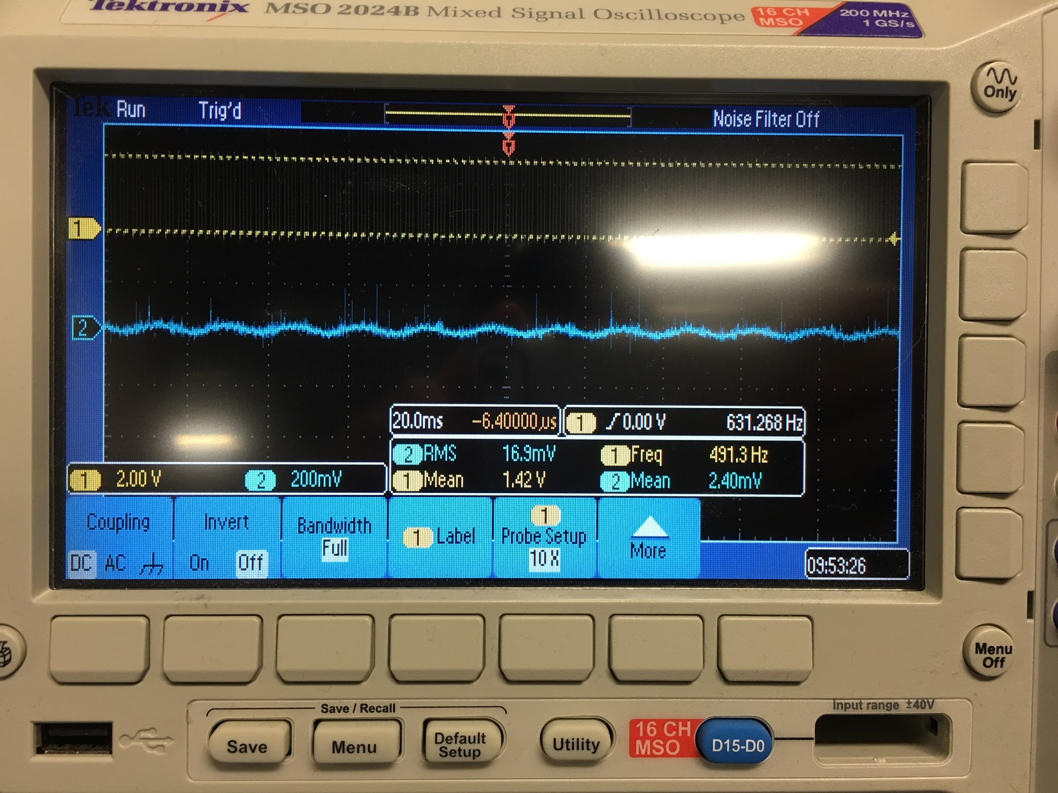
Results - DC Offset
Idle voltage = 17 mVrms
Running Voltage = 17 mVrms
Virtually no DC Offset

Slide 17
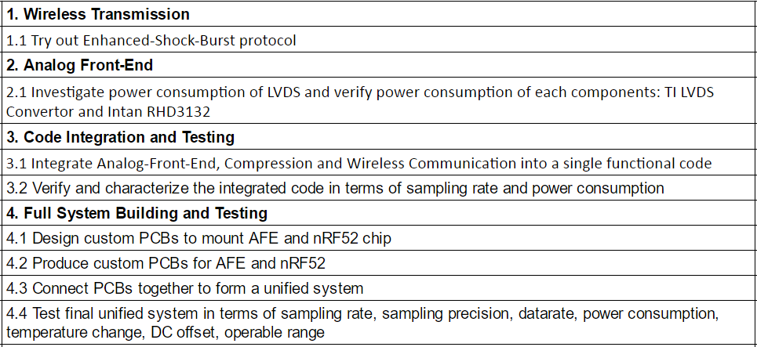
Last Cycle Specs

Slide 18
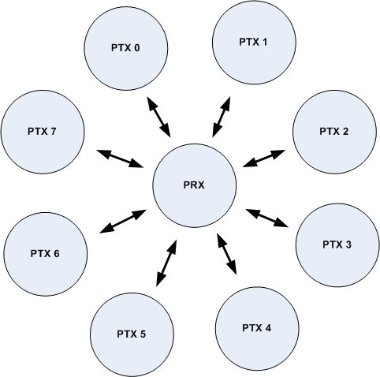
Enhanced Shock Burst (ESB protocol)
NRF51 nrf_esb
Micro_esb
Advantages:
Higher Throughput
Disadvantages:
Proprietary Protocol
Higher Energy Consumption

Slide 19
Investigating Power Consumption of LVDS and Intan
Intan (with LVDS enabled) = 10.7 mA
Nordic nrf52 = 6 mA
LVDS = 5.3 mA
“Enabling LVDS mode on the RHD2000 increases current consumption by approximately 5.7 mA. ”
Intan RHD2000 Datasheet P.12
Intan (w/ LVDS)+ Nordic nrf52 + LVDS = 22mA = 528 mAh (for 24 hrs)
Intan + Nordic nrf52 = 11mA = 264 mAh (for 24 hrs)

Slide 20
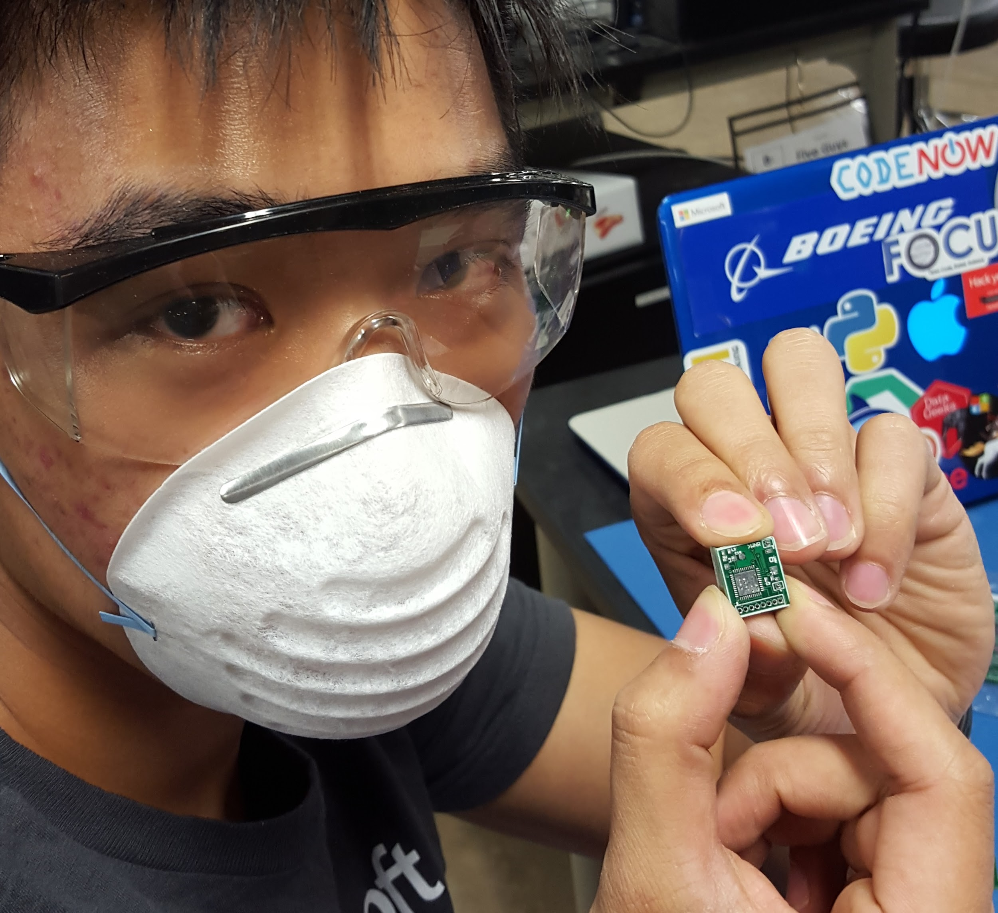
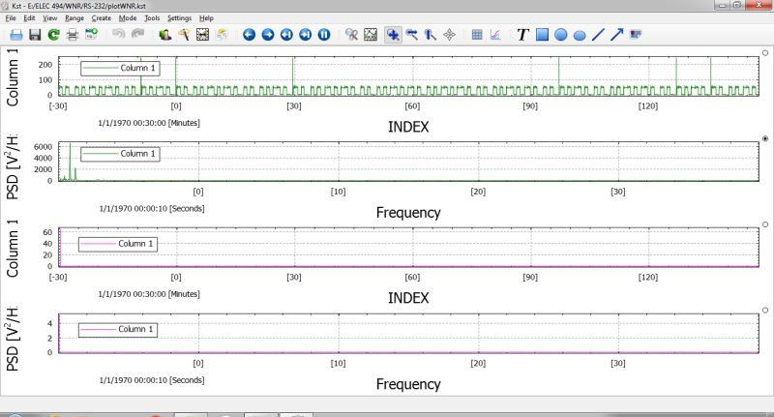
Integrate into Complete System

Slide 21
Verify Sampling Rate and Power of System

Slide 22
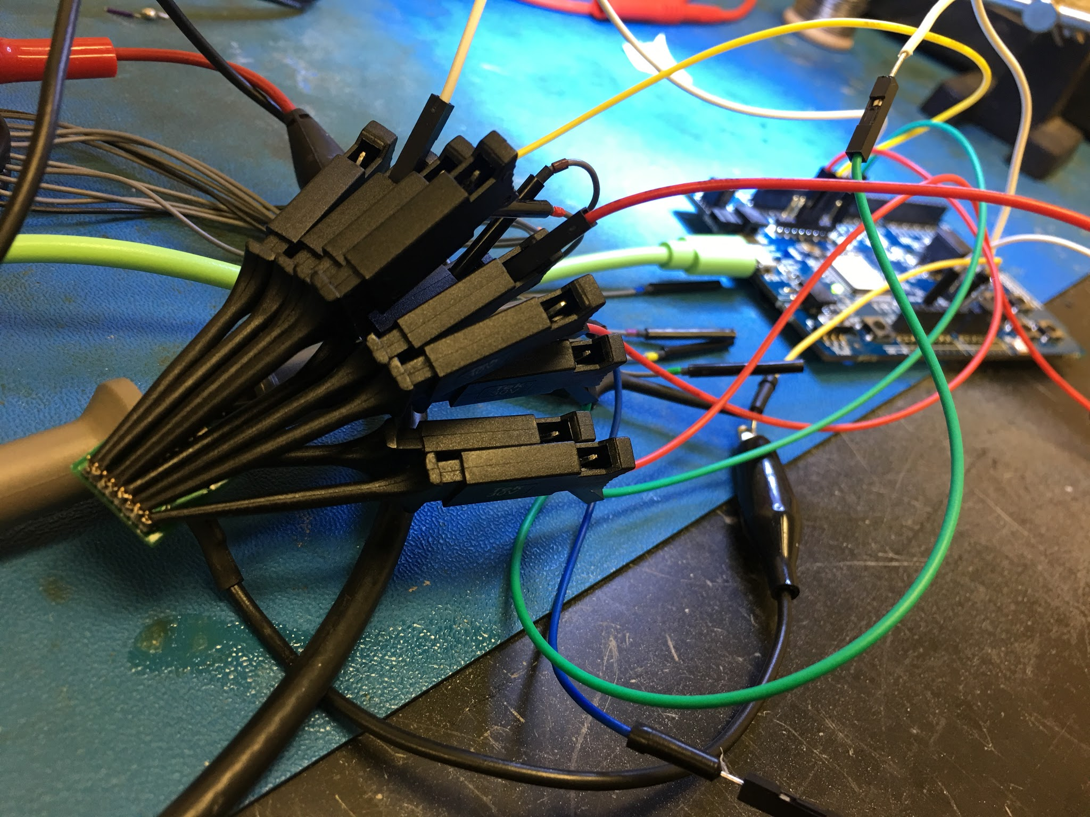
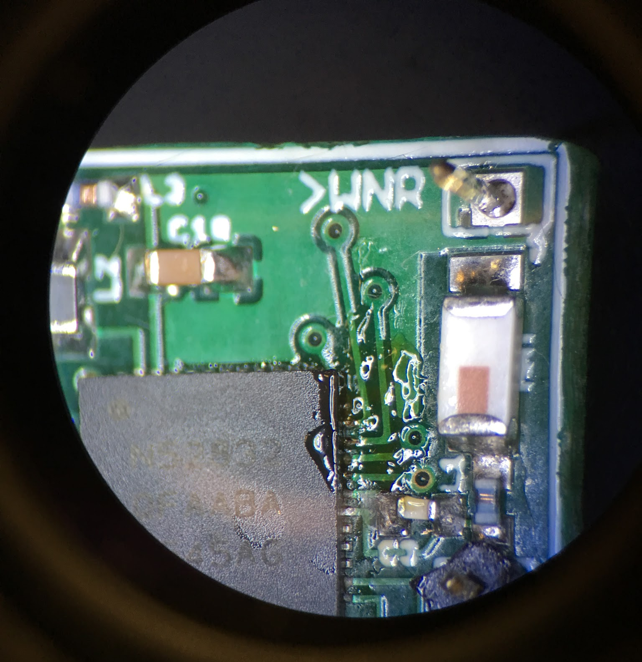
Design Custom PCBs for AFE and Nordic

Slide 23
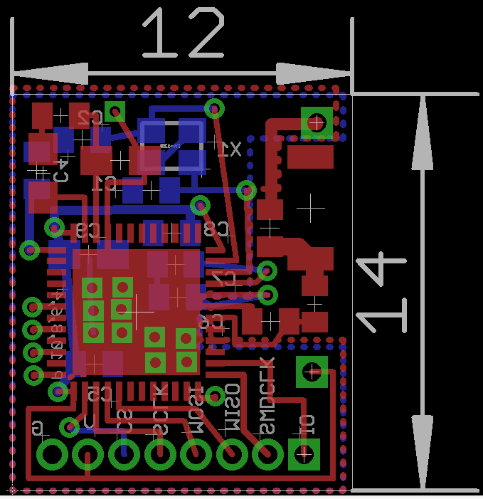
Nordic PCB Design

Slide 24
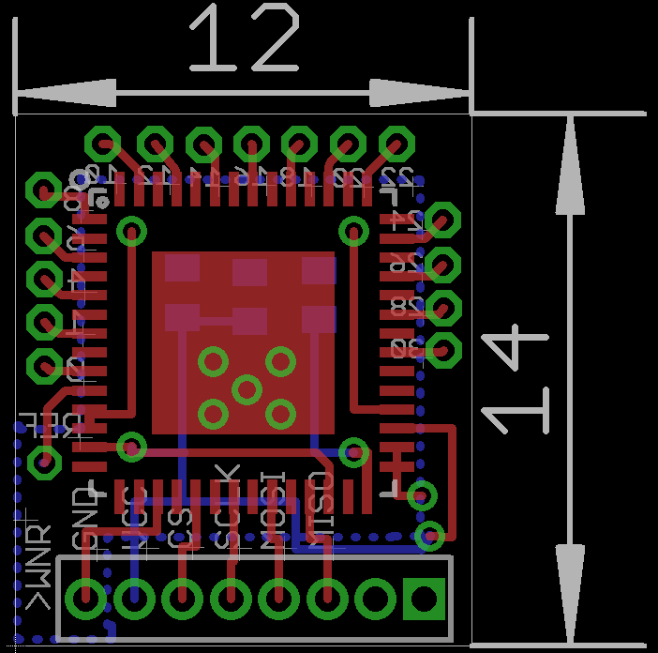
Intan PCB Design

Slide 25
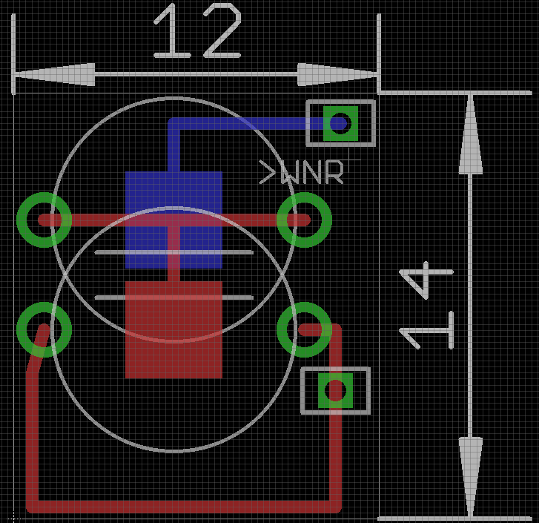
Battery PCB Design

Slide 26
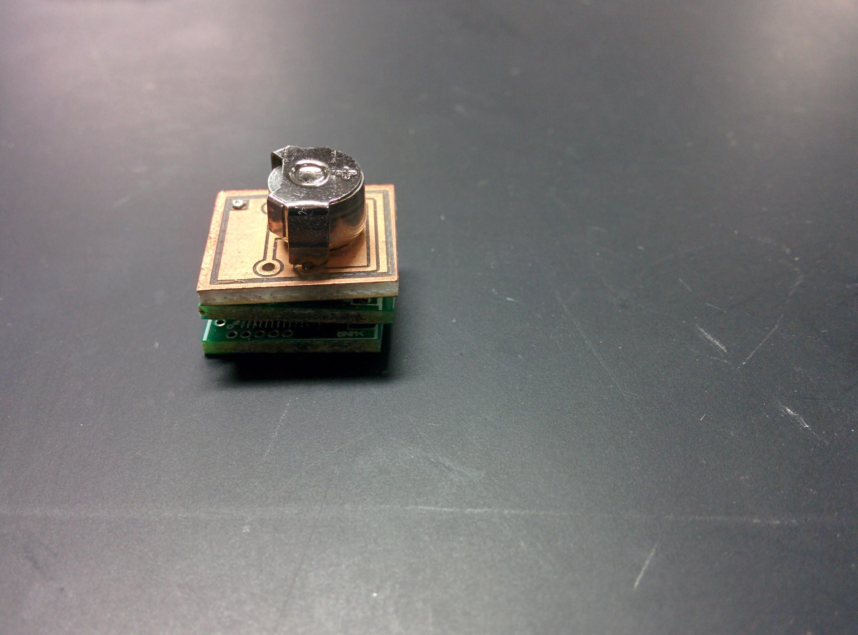
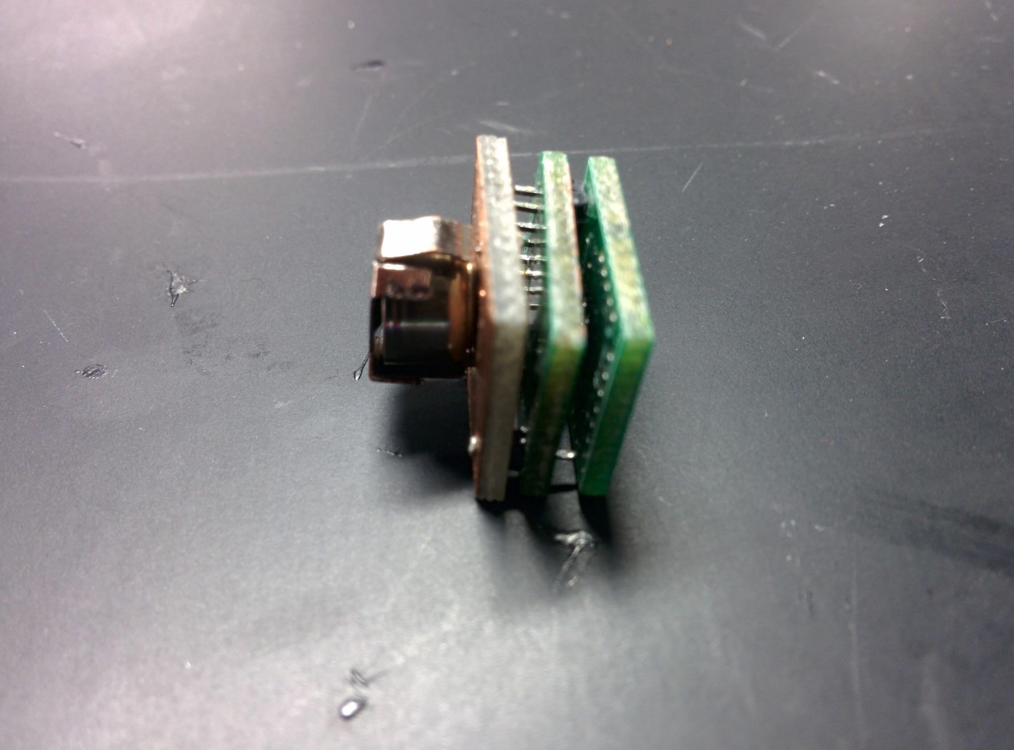
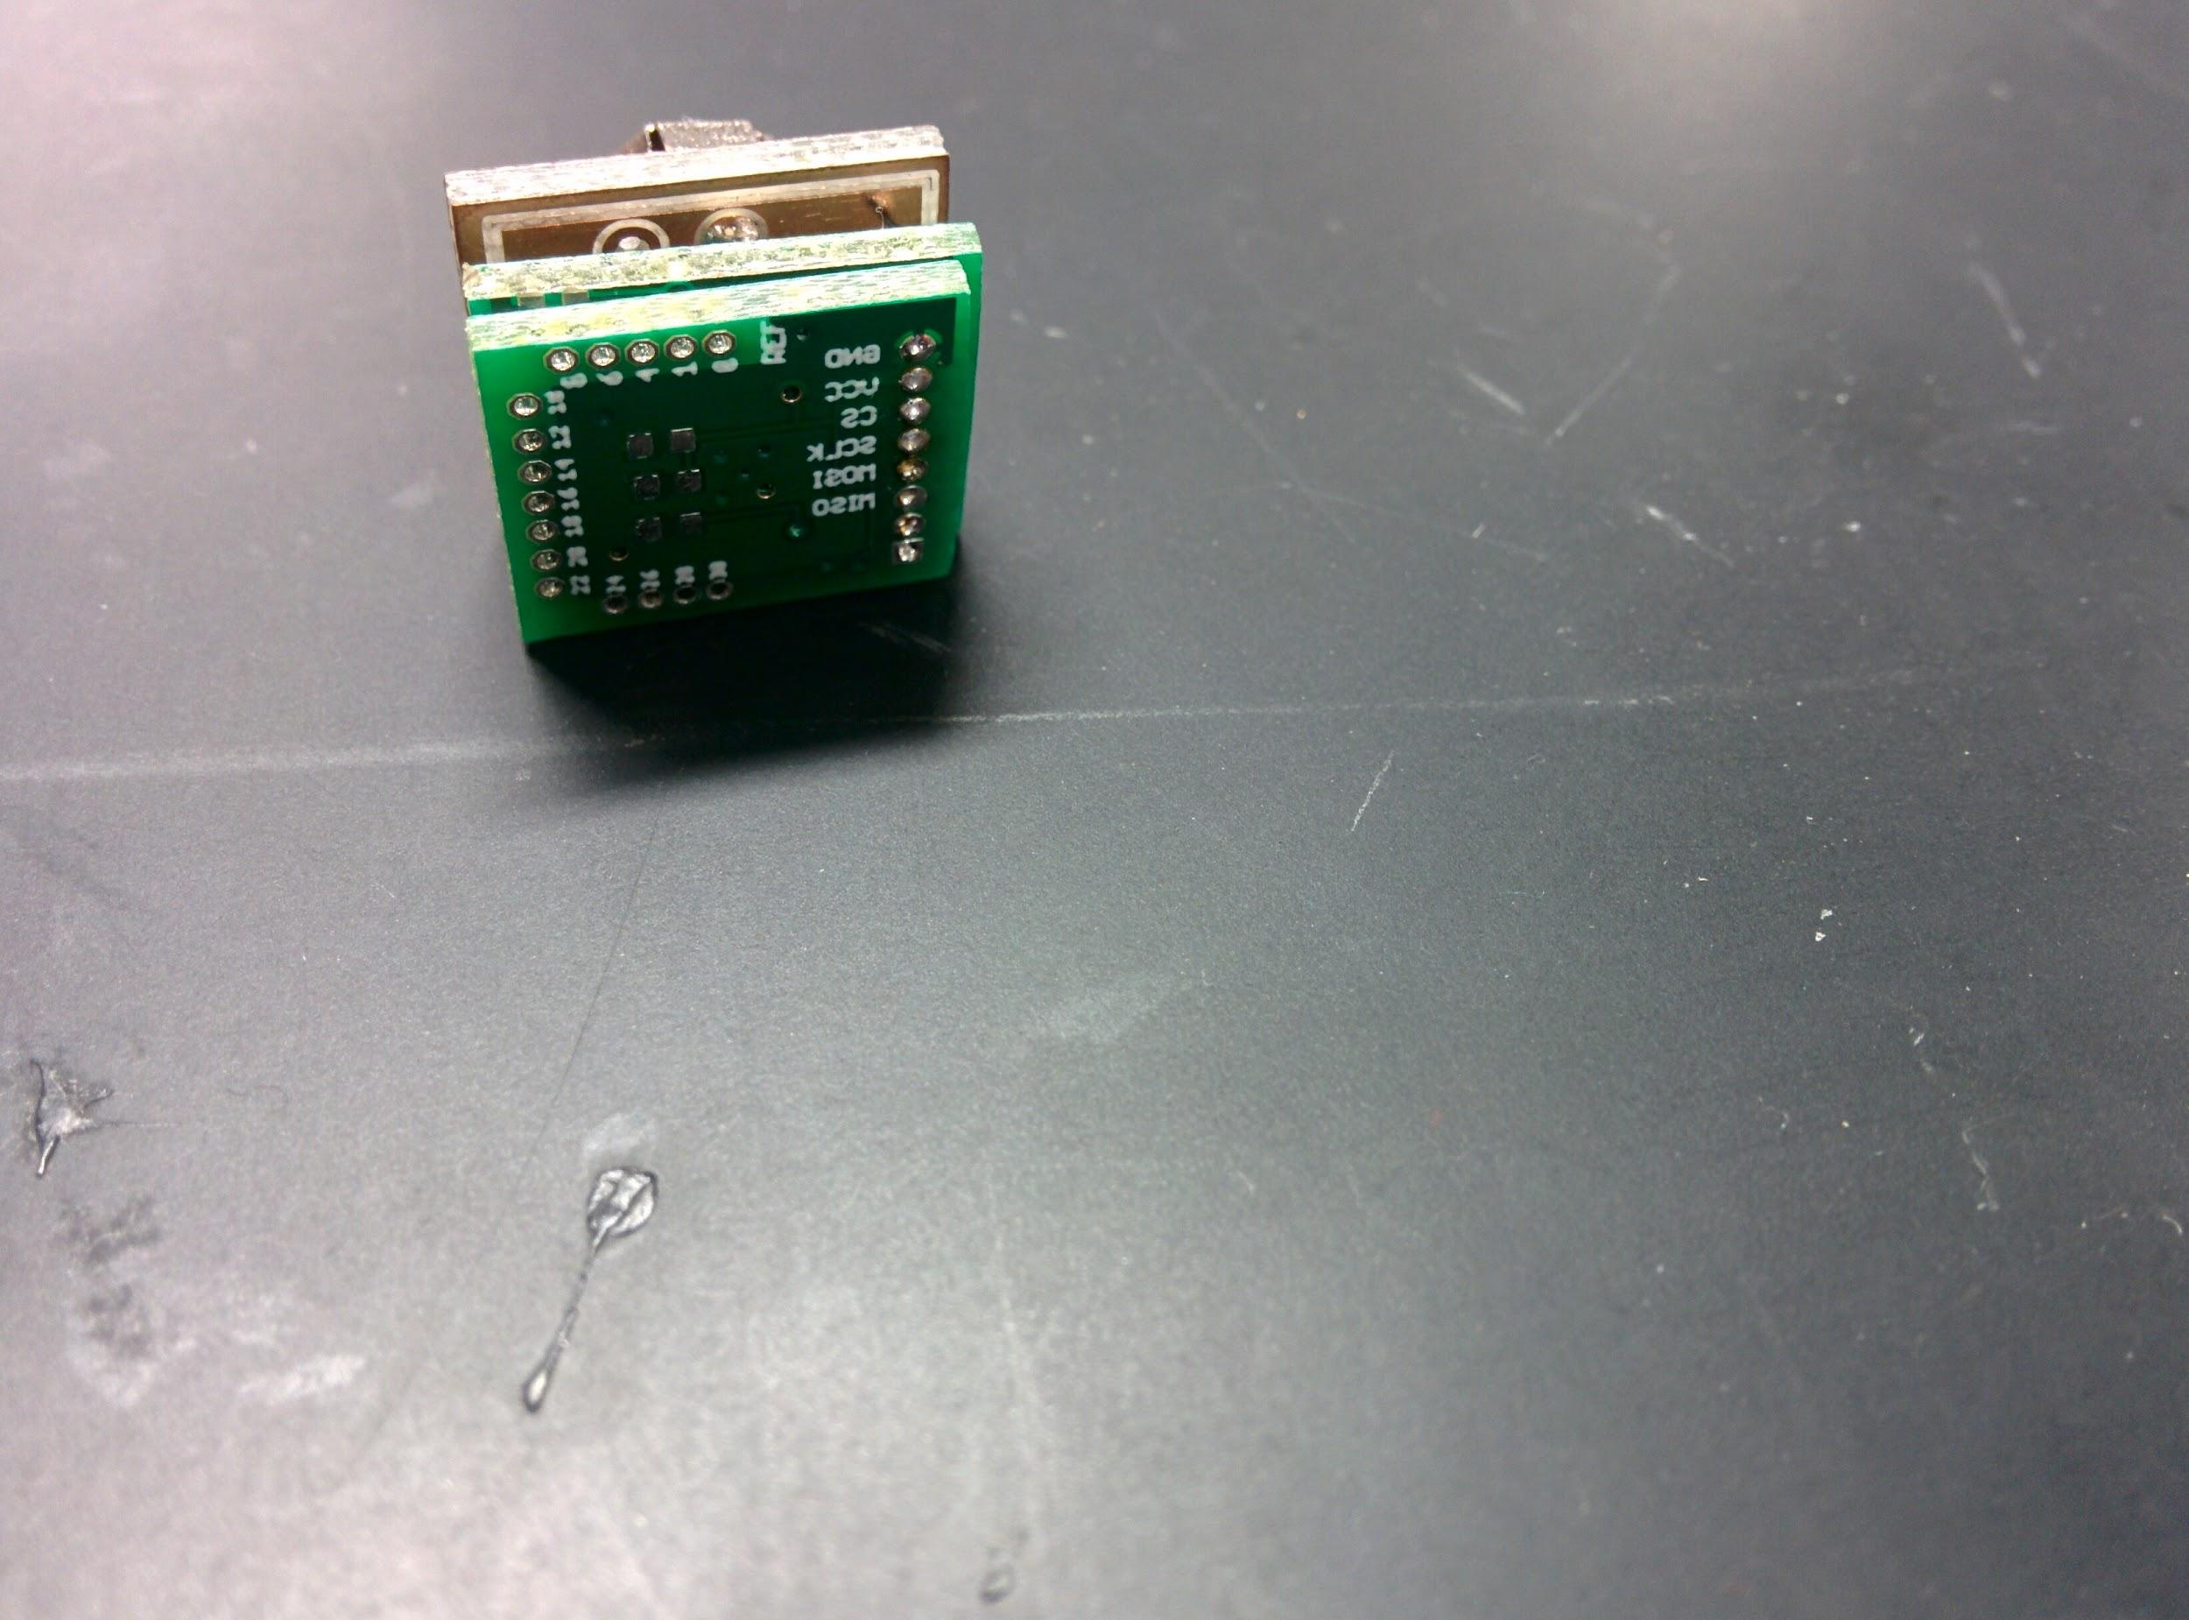
Combine PCBs into Full System

Slide 27
Testing of Final Unified System

